Slide 1
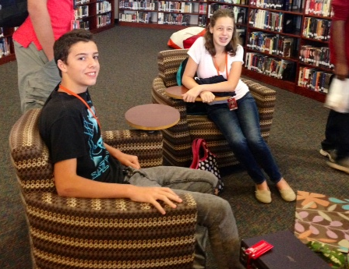
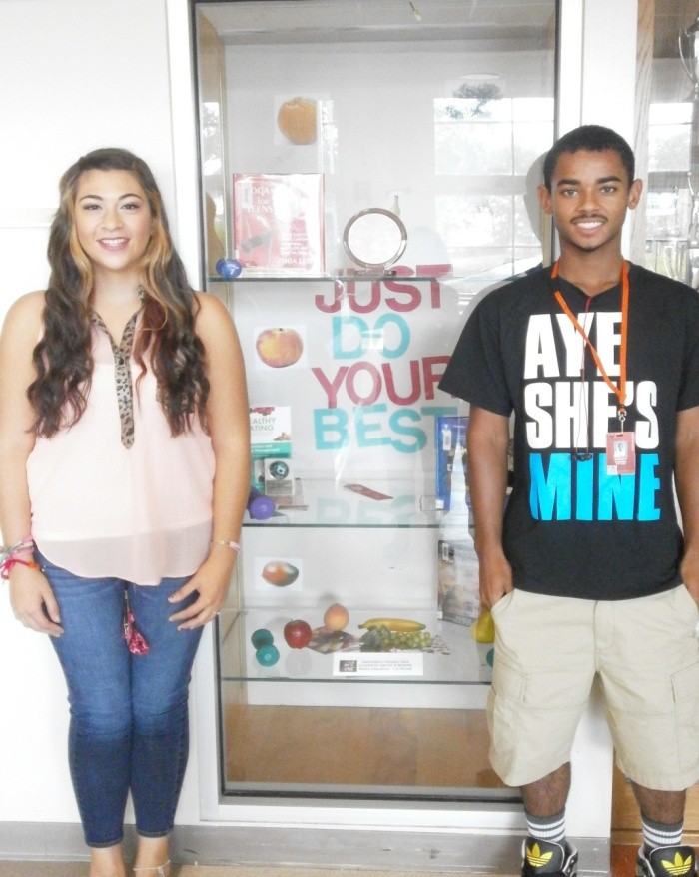
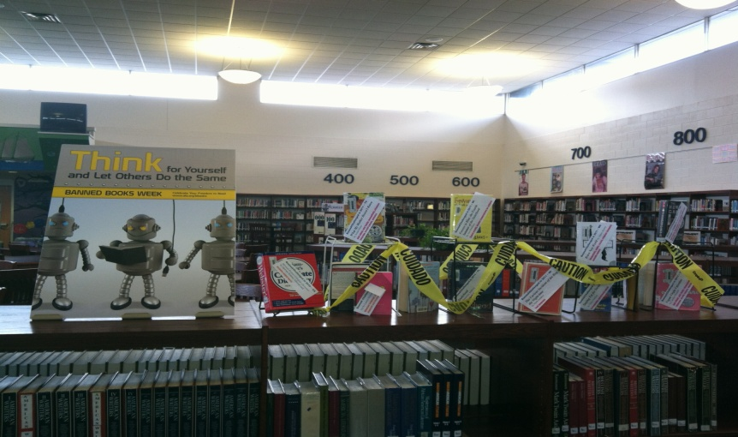
Mauldin high school library monthly report
Stacy Henderson, Librarian
Diane Morris, Librarian
Suzette Simpson, Clerk
Mr. Scott Rhymer, Principal
August/September 2013
Compiled by Abbie Richey, Intern

Slide 2
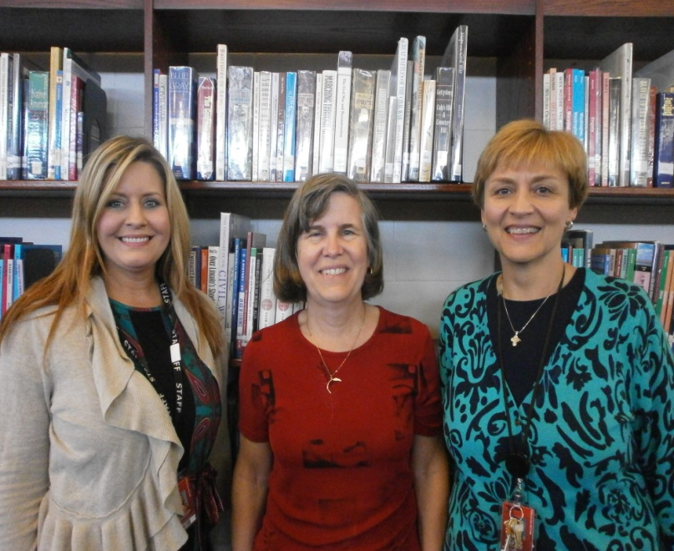
Mauldin High School Library Monthly Report
Monthly Highlights:
The media center welcomes
Stacy Henderson, who replaces
Patty Bynum.
Media center staff assisted with
checking out textbooks, making ID
badges, setting up a sign-up station for
the Stampede during Orientation and
Open House.
Books, videos, and other materials were purchased to support Common Core standards.
Media Center Orientation for new teachers was held on 9/19.
We celebrated Banned Books Week during the week of September 22- 28.
The 2013 Mavs Read program was promoted to students through digital book trailers and monthly prize drawings.

Slide 3
Mauldin High School Library Monthly Report
Collaborations
Collaborative Topics/ Units Covered:
Library Orientation for English I Classes
Book talk with SAT class
ESOL – Rosetta Stone
Elizabethan Era resource list for English I
Immigration books pulled and resource list for Global I
Civil Disobedience resource list for English II Honors
 | # of units taught collaboratively | # of teachers at MHS | % of teachers collaborated with
August | 2 units (2 teachers, 7 classes) | 110 | 2%
September | 5 units (5 teachers, 15 classes) | 110 | 5%
October
November
December
January
February
March
April
May
June

Slide 4
MHS Library Monthly Report – Library Usage
Month | Days Open/Class Periods Library Open | Class Periods w/ Classes in Library | Class Periods w/ Librarian Teaching | Classes Using Computers (No Instruction) | Total Monthly Circulation | Total Student Circulation | Per Pupil Check-out Rate | Total Walk-In Patrons | Average # of People Per Day | Tech Requests
August | 9/53 | 9 | 7 | 2 | 870 | 666 | .3 books/ student | 1865 | 233 | 50
September | 20/140 | 26 | 12 | 14 | 1819 | 1303 | .6 books/ student | 4722 | 236 | 152
October
November
December
January
February
March
April
May
June
Totals

